Slide 2
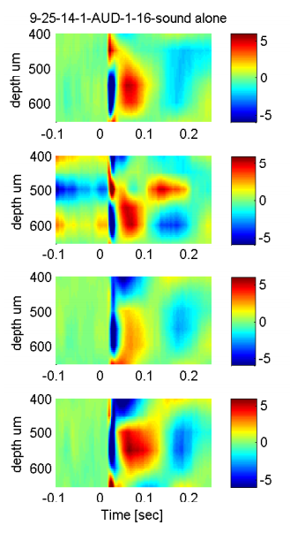
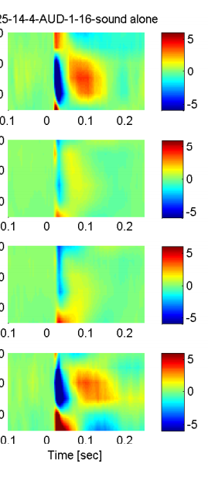
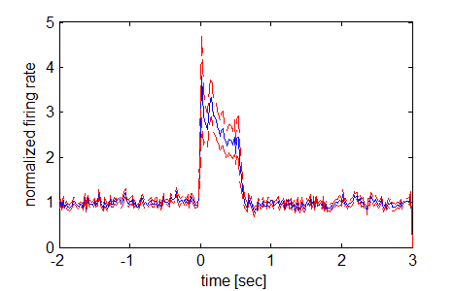
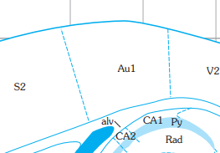
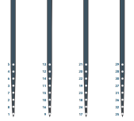
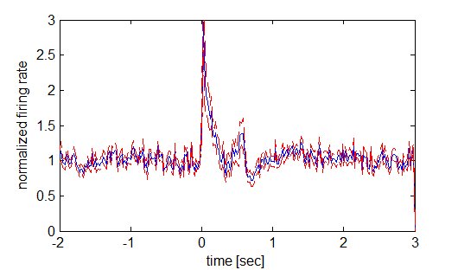
CSD and Spectral/pop_CSD_sound_only (snipped from pdf)
Figure 2: Scopolamine reduces noise-evoked intra-cortical current sources in auditory cortex. (left) Illustration of recording electrode/infusion pipette configuration and position within auditory cortex.

Slide 3
[0.1496,0.2536,0.4361,0.3333,0.9801,0.5861],
[0.6656,0.0508,0.0266,0.2619,0.5673,0.1307],
[0.4139,0.0049,0.0332,0.1164,0.1084,0.2449],
[0.9856,0.7057,0.8107,0.9412,0.7830,0.2704]
0-150 ms window
[0.1627,0.1254,0.6833,0.2250,0.5929,0.9054], [0.8266,0.0392,0.0160,0.1139,0.8856,0.1543], [0.4223,0.0324,0.0816,0.1256,0.2046,0.2706], [0.3390,0.7139,0.7930,0.4116,0.9081,0.3737]
50-150 ms window

